Slide 1
NoJetsTO Campaign Overview and Updates
NoJetsTO Chair
Norm Di Pasquale

Slide 2
Who is NoJetsTO
Non-partisan citizens coalition that:
  Strives to protect existing Tripartite Agreement
  Opposes expansion of the Island Airport
  Supports the mixed-used vision of Waterfront Toronto
What we are NOT:
  Opposed to current Island Airport
  Opposed to jets per se – Porter is more than
welcome to fly out of Pearson

Slide 3
Campaign Origins & Context
Long history of wrong-headed island airport proposals
1996: Jets promised by Mike Harris
2002: Lastman gets Council vote for airport bridge
2003: Miller-led Council repeals approval
2011: Ports Toronto builds a tunnel instead of bridge
2013: Island Airport expansion push, NoJetsTO forms
2014: City Council passes phased framework for island airport expansion
2015: Federal Liberals oppose jet expansion, victory for NoJetsTO!
March 2026: Premier Ford calls for jets, strips environmental rights & protections via Bill 5, threatens to take airport land from city

Slide 4
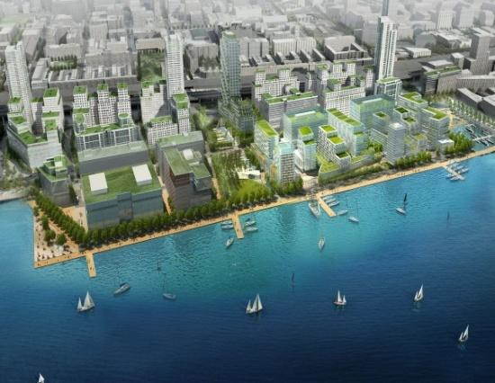
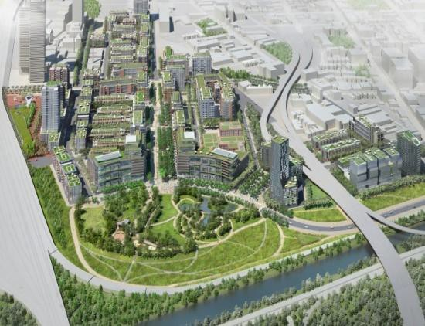
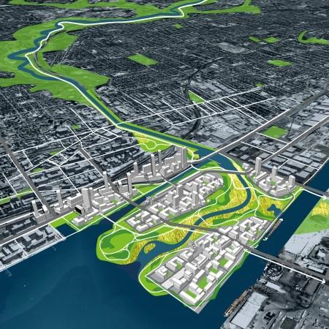
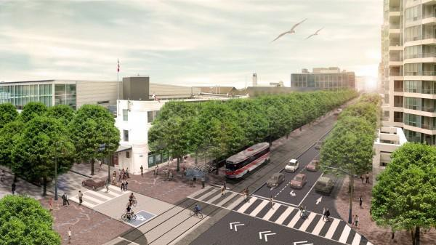
Impacting Waterfront Vision
17 Million people visit Harbourfront every year
1.5 Million people visit the Toronto Islands
40,000 jobs already created, billions in ROI
75,000 housing units planned in the Port Lands area
East Bayfront
Lower Don Lands
Lower Don Lands
Queens Quay
Revitalization

Slide 5
Waterfront Toronto put it best:
“At what point does the Island Airport stop being and airport in a thriving revitalized waterfront and become an airport overwhelming the waterfront?”

Slide 6

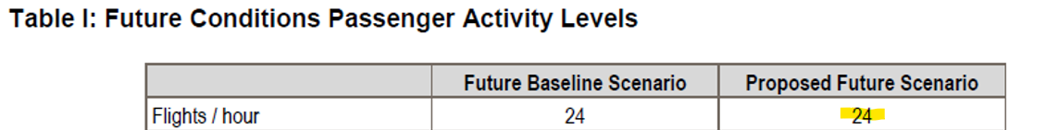

Slide 7
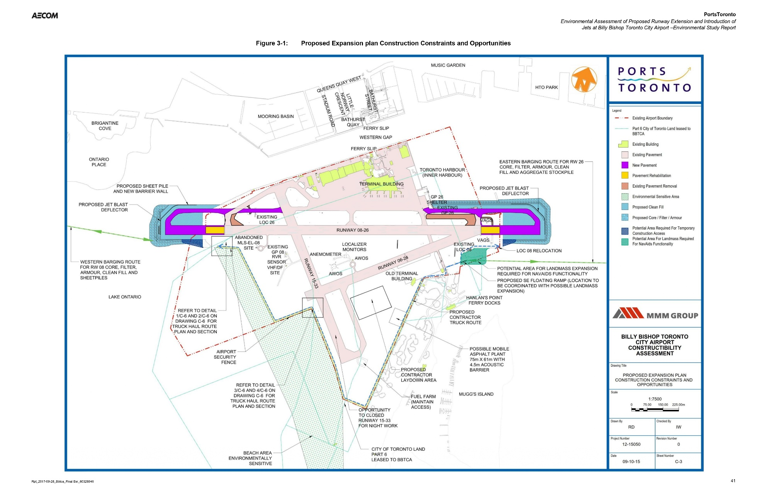
What does expanding the airport for jets look like?

Slide 8
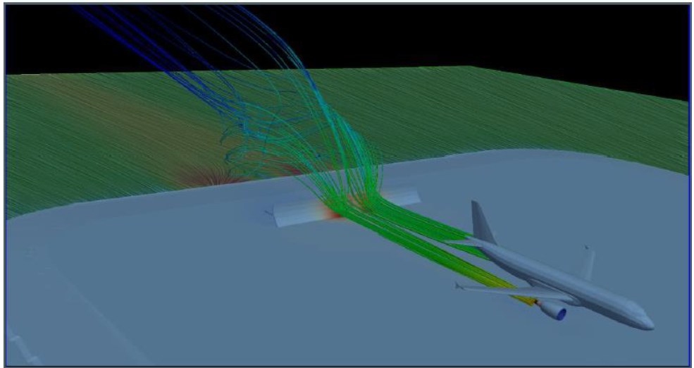
Jet Blasts up to 190km/h!

Slide 9
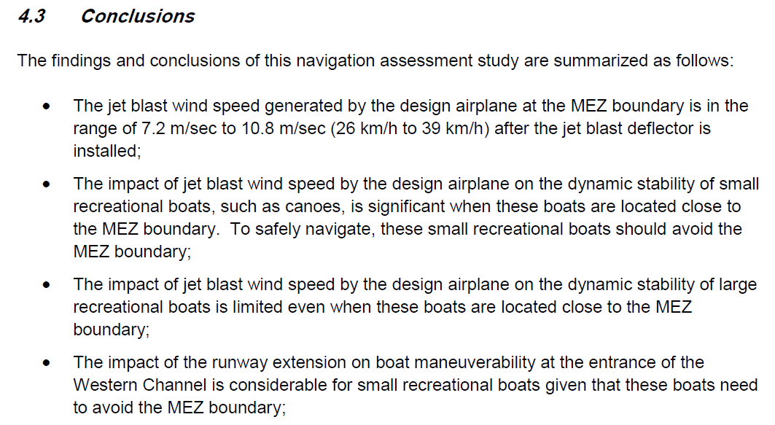
Jet blast impacts

Slide 10
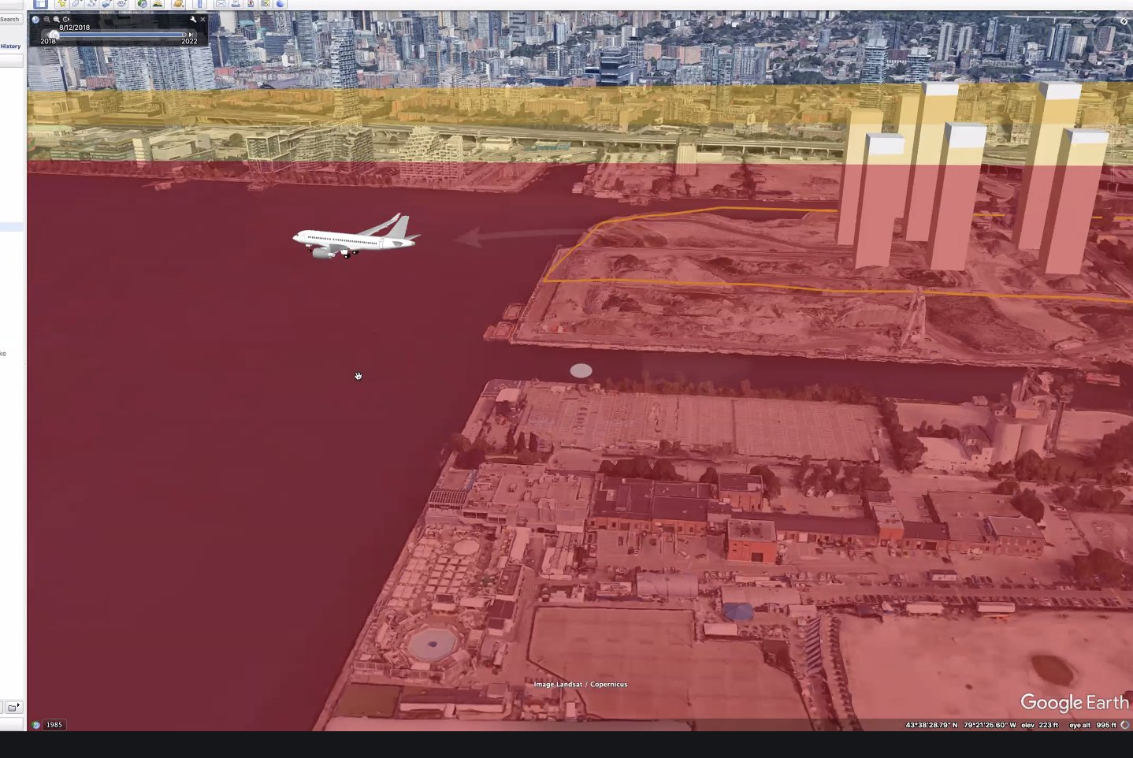
Jets safety area limits housing

Slide 11
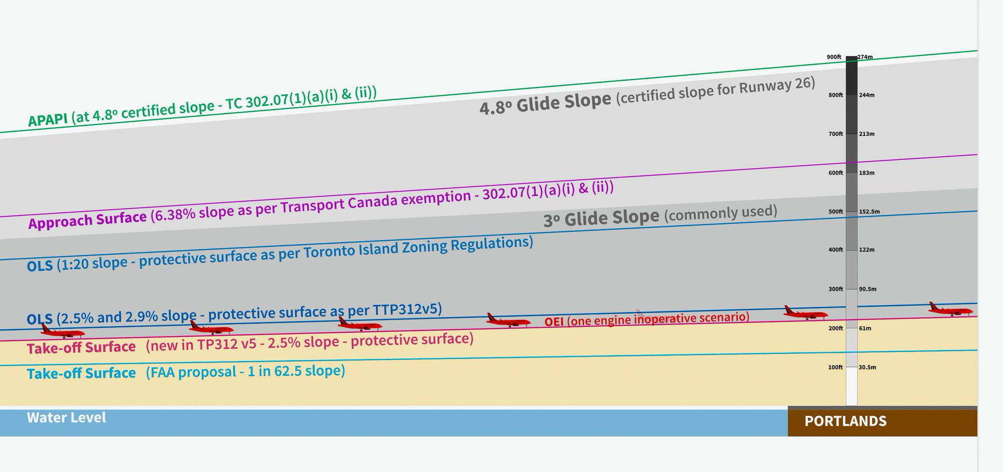
How much will jets impact building heights? A lot!

Slide 12
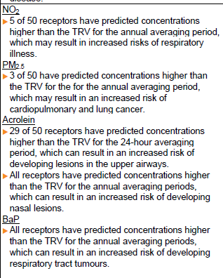
Public Health
“Increased risks of”:
respiratory illness
cardiopulmonary and lung cancer
lesions in the upper airways
nasal lesions
respiratory tract tumours
Higher amount of Ultrafine particles which:
Can travel up the olfactory nerves to the brain and cause cerebral and nervous system dysfunction

Slide 13
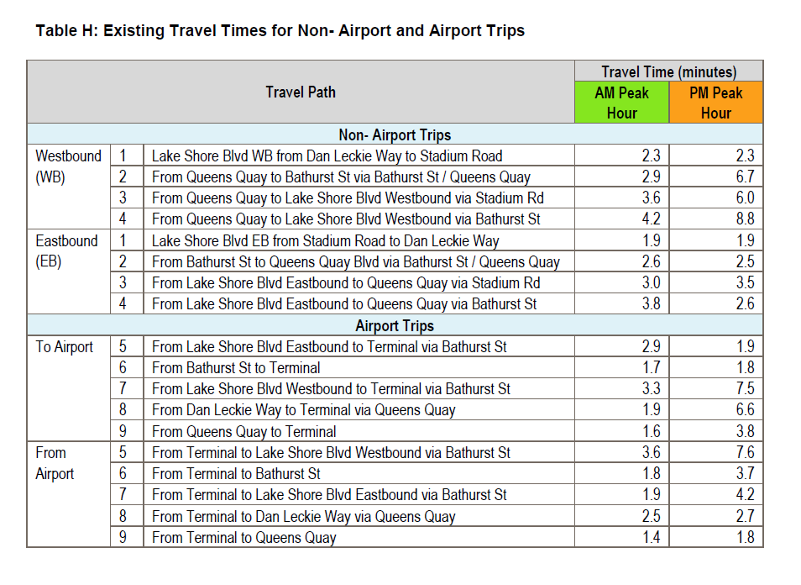
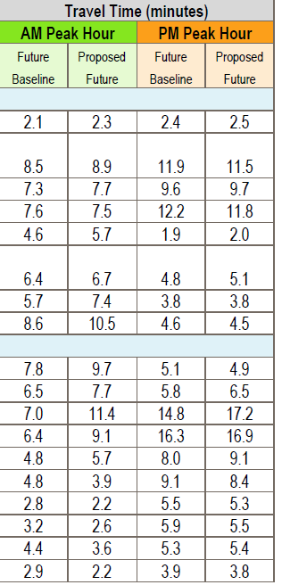
Traffic increases up 400%!

Slide 14
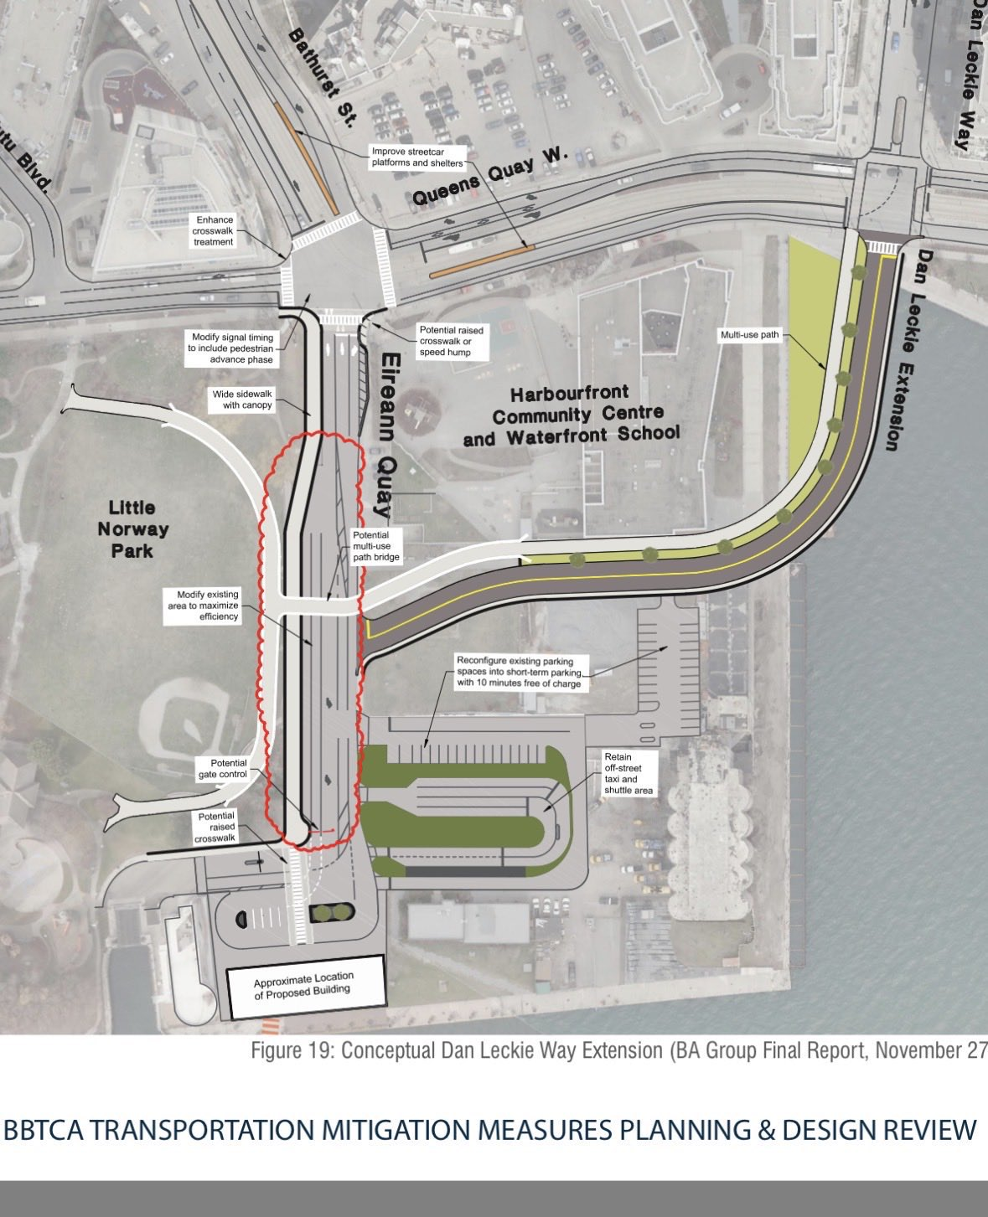
How do they want to address traffic? A road through a school!

Slide 15
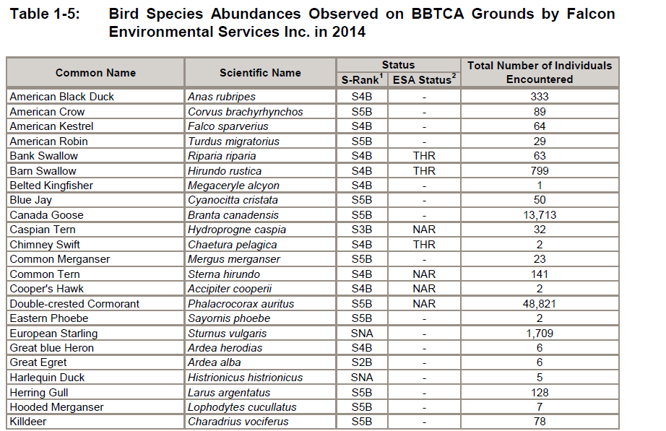
Birds & Butterfly impact

Slide 16

Where does the Federal Government stand on jets at the island airport?

Slide 17
How Residents Can Support NoJetsTO
Stay Informed and Engaged
  Concerned Residents should stay updated on developments and understand how jet expansion affects communities and the waterfront. Sign the petition and subscribe for updates at NoJetsTO.com
Participate and Advocate
  Signing NoJetsTO petitions, attending public meetings, and engaging with officials amplifies community concerns. Also volunteer!
Support Campaigns and Donations
  Social media campaigns and donations help NoJetsTO raise awareness and influence policy decisions effectively.

